Slide 1

PRACTICAL
GUIDE TO
GO
Notes:
Hiking Gopher Design: https://github.com/egonelbre/gophers

Slide 2


Slide 3

HELLO
Scott Kay

Slide 4
github.com/prebid/prebid-server

Slide 5
http://go.dev
LANGUAGE SYNTAX

Slide 6

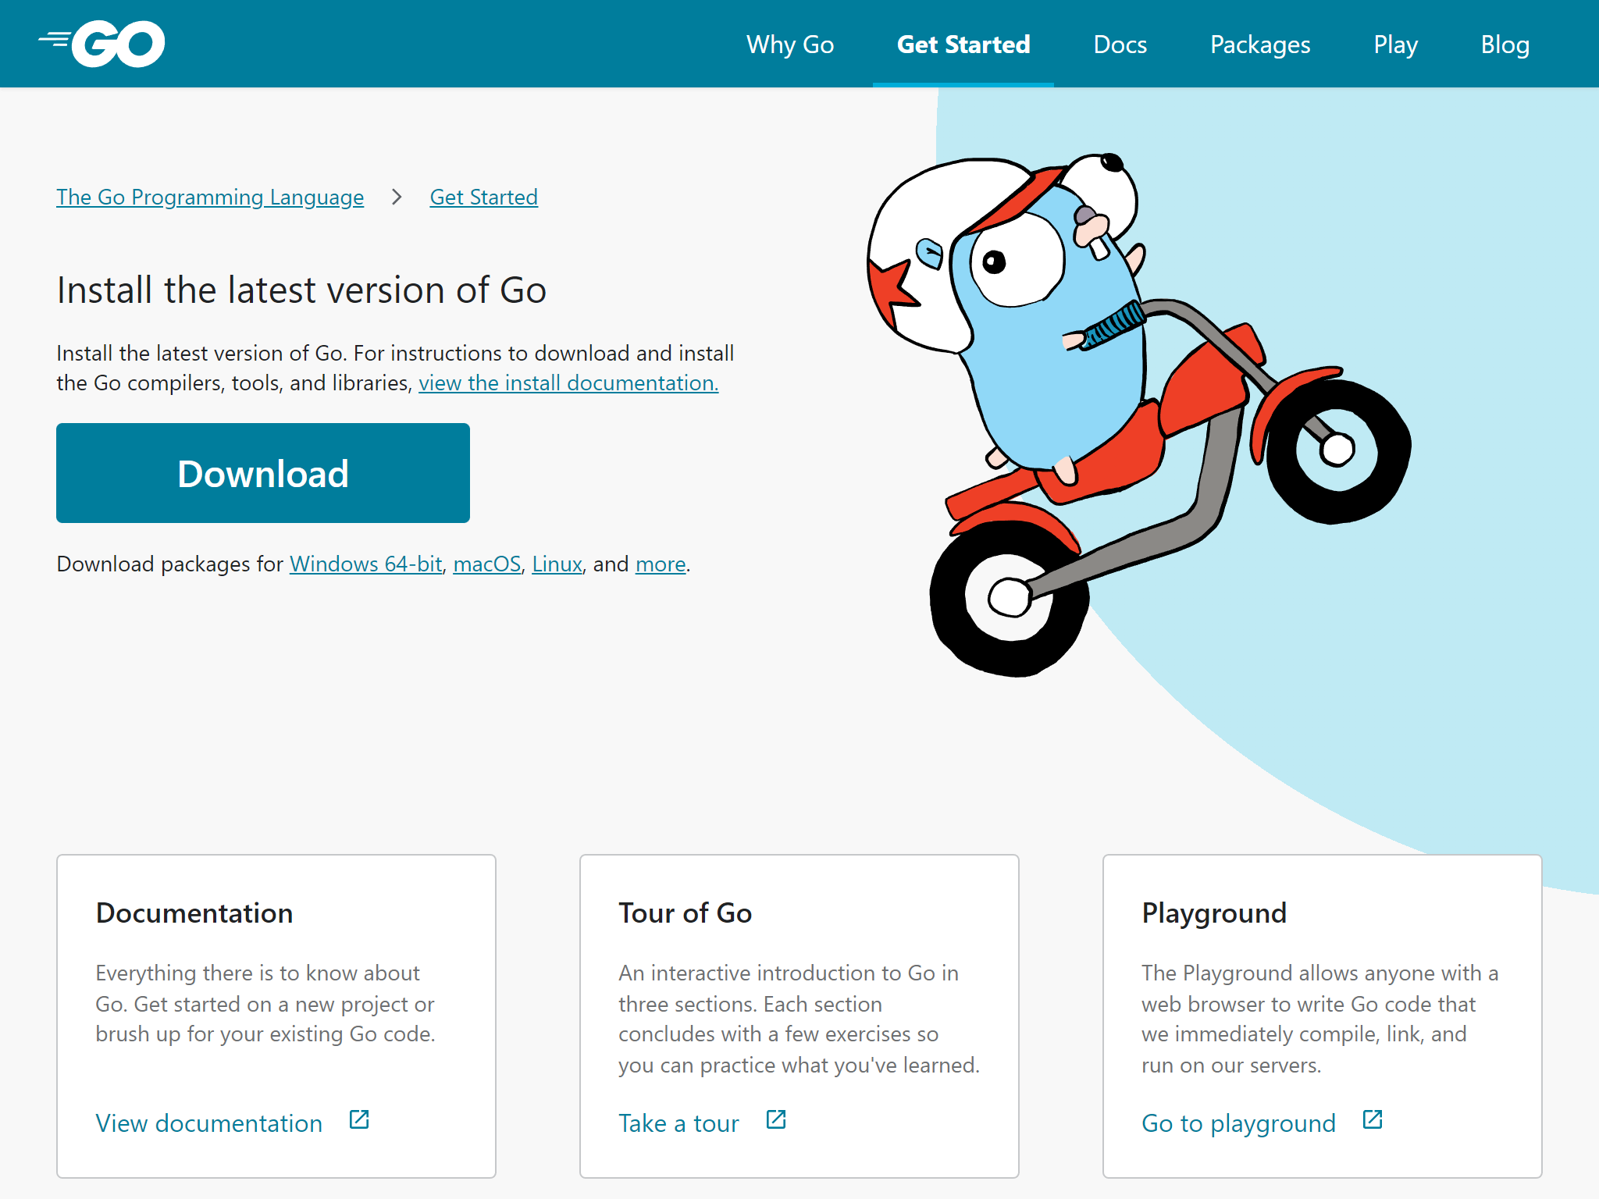
LANGUAGE SYNTAX

Slide 7
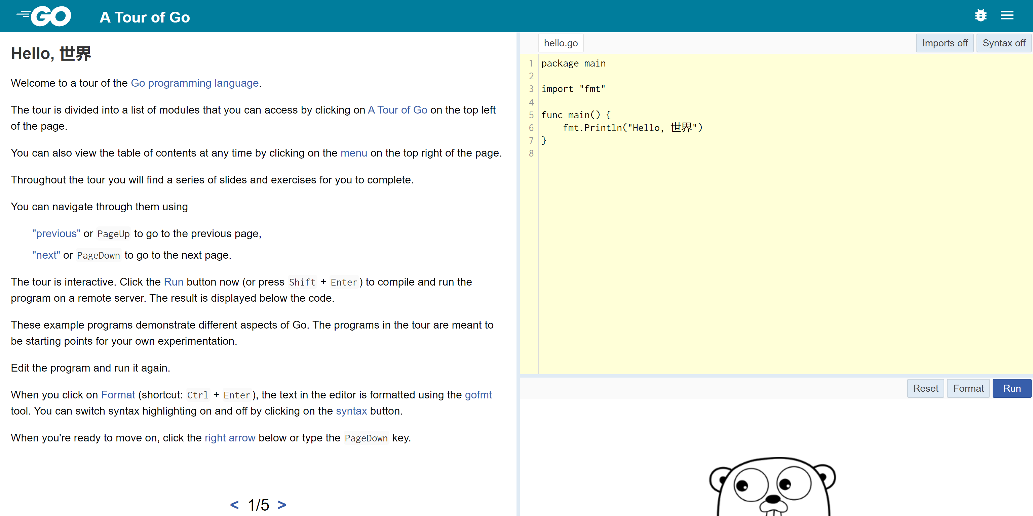
LANGUAGE SYNTAX

Slide 8
AGENDA
Brief Overview of Go
Create a Go App
Discover & Use Modules
Write Tests
Useful Tidbits (aka, stuff I learned the hard way)

Slide 9

GO
Minimalistic
Garbage Collected
Fast Compilation
Concurrency Primitives
Duck Typing
Open-Source Ecosystem
Generics!

Slide 10
break default for interface select case defer go map struct chan else goto package switch const fallthrough if range type continue for import return var
KEYWORDS
TYPES
any complex64 int real uint16 bool complex128 int8 rune uint32
byte error int16 string uint64
comparable float32 int32 uint uintptr
complex float64 int64 uint8
BUILT-IN
append copy imag make panic recover
cap delete iota new print true
close false len nil println delete

Slide 11
GOOD FOR
LESS GOOD FOR
Server Side
API & Web Backends
Command Line Tools
Infrastructure Services
Dev Ops
Client Side
Desktop App
Mobile App
HTML Web App

Slide 12








WHO USES GO?

Slide 13
Go 1.19
CURRENT VERSION

Slide 14
OPEN-SOURCE ECOSYSTEM
Share code, not binaries.
Packages (called modules) are repositories.
Import repositories by URL.
Tags are used for version control.
Indexed by go.dev.

Slide 15



IDE
VS Code
GoLand
Vim

Slide 16
Code
DEMONSTRATION

Slide 17
Garbage Collection
200MB LIMIT
150MB LIMIT
200MB
150MB
100MB
75MB
GC
Notes:
Twitch Blog: https://blog.twitch.tv/en/2019/04/10/go-memory-ballast-how-i-learnt-to-stop-worrying-and-love-the-heap/

Slide 18
Garbage Collection
300MB LIMIT
GOMEMLIMIT
300MB
150MB
100MB
75MB
GC
Notes:
Twitch Blog: https://blog.twitch.tv/en/2019/04/10/go-memory-ballast-how-i-learnt-to-stop-worrying-and-love-the-heap/

Slide 19
Resources
Learn Go
https://go.dev
Curated Package Collection
https://awesome-go.com
Go Package Search
https://pkg.go.dev
Standard Library Docs
https://pkg.go.dev/std

